Slide 1
Deep Margin Cosine Autoencoder-Based Medical Hyperspectral Image Classification for Tumor Diagnosis
Meiling Wang et al.
IEEE Transactions on Instrumentation and Measurement
2023
Presented By
Rudra Pratap Singh
24/CS/378
Saksham Kumar
24/CS/393
Sarthak Tomar
24/CS/403
Shobhit Narera
24/CS/423

Slide 2
Problem
Currently present Tumour Detection methods involve time taking invasive procedures, that harm the body and require experts in order to accurately determine their presence. Other non invasive imaging techniques like MRIs and CAT Scans are unable to identify the precise location for surgery, and are also time taking.
Due to this machine learning was explored for quick and accessible detection and locating of tumours, with emphasis on Brain Tumours, because of them being the most trivial ones !
The paper proposes a novel technique that aims to solve this problem using sophisticated Deep Learning Methodologies, utilizing Hyperspectral Images

Slide 3
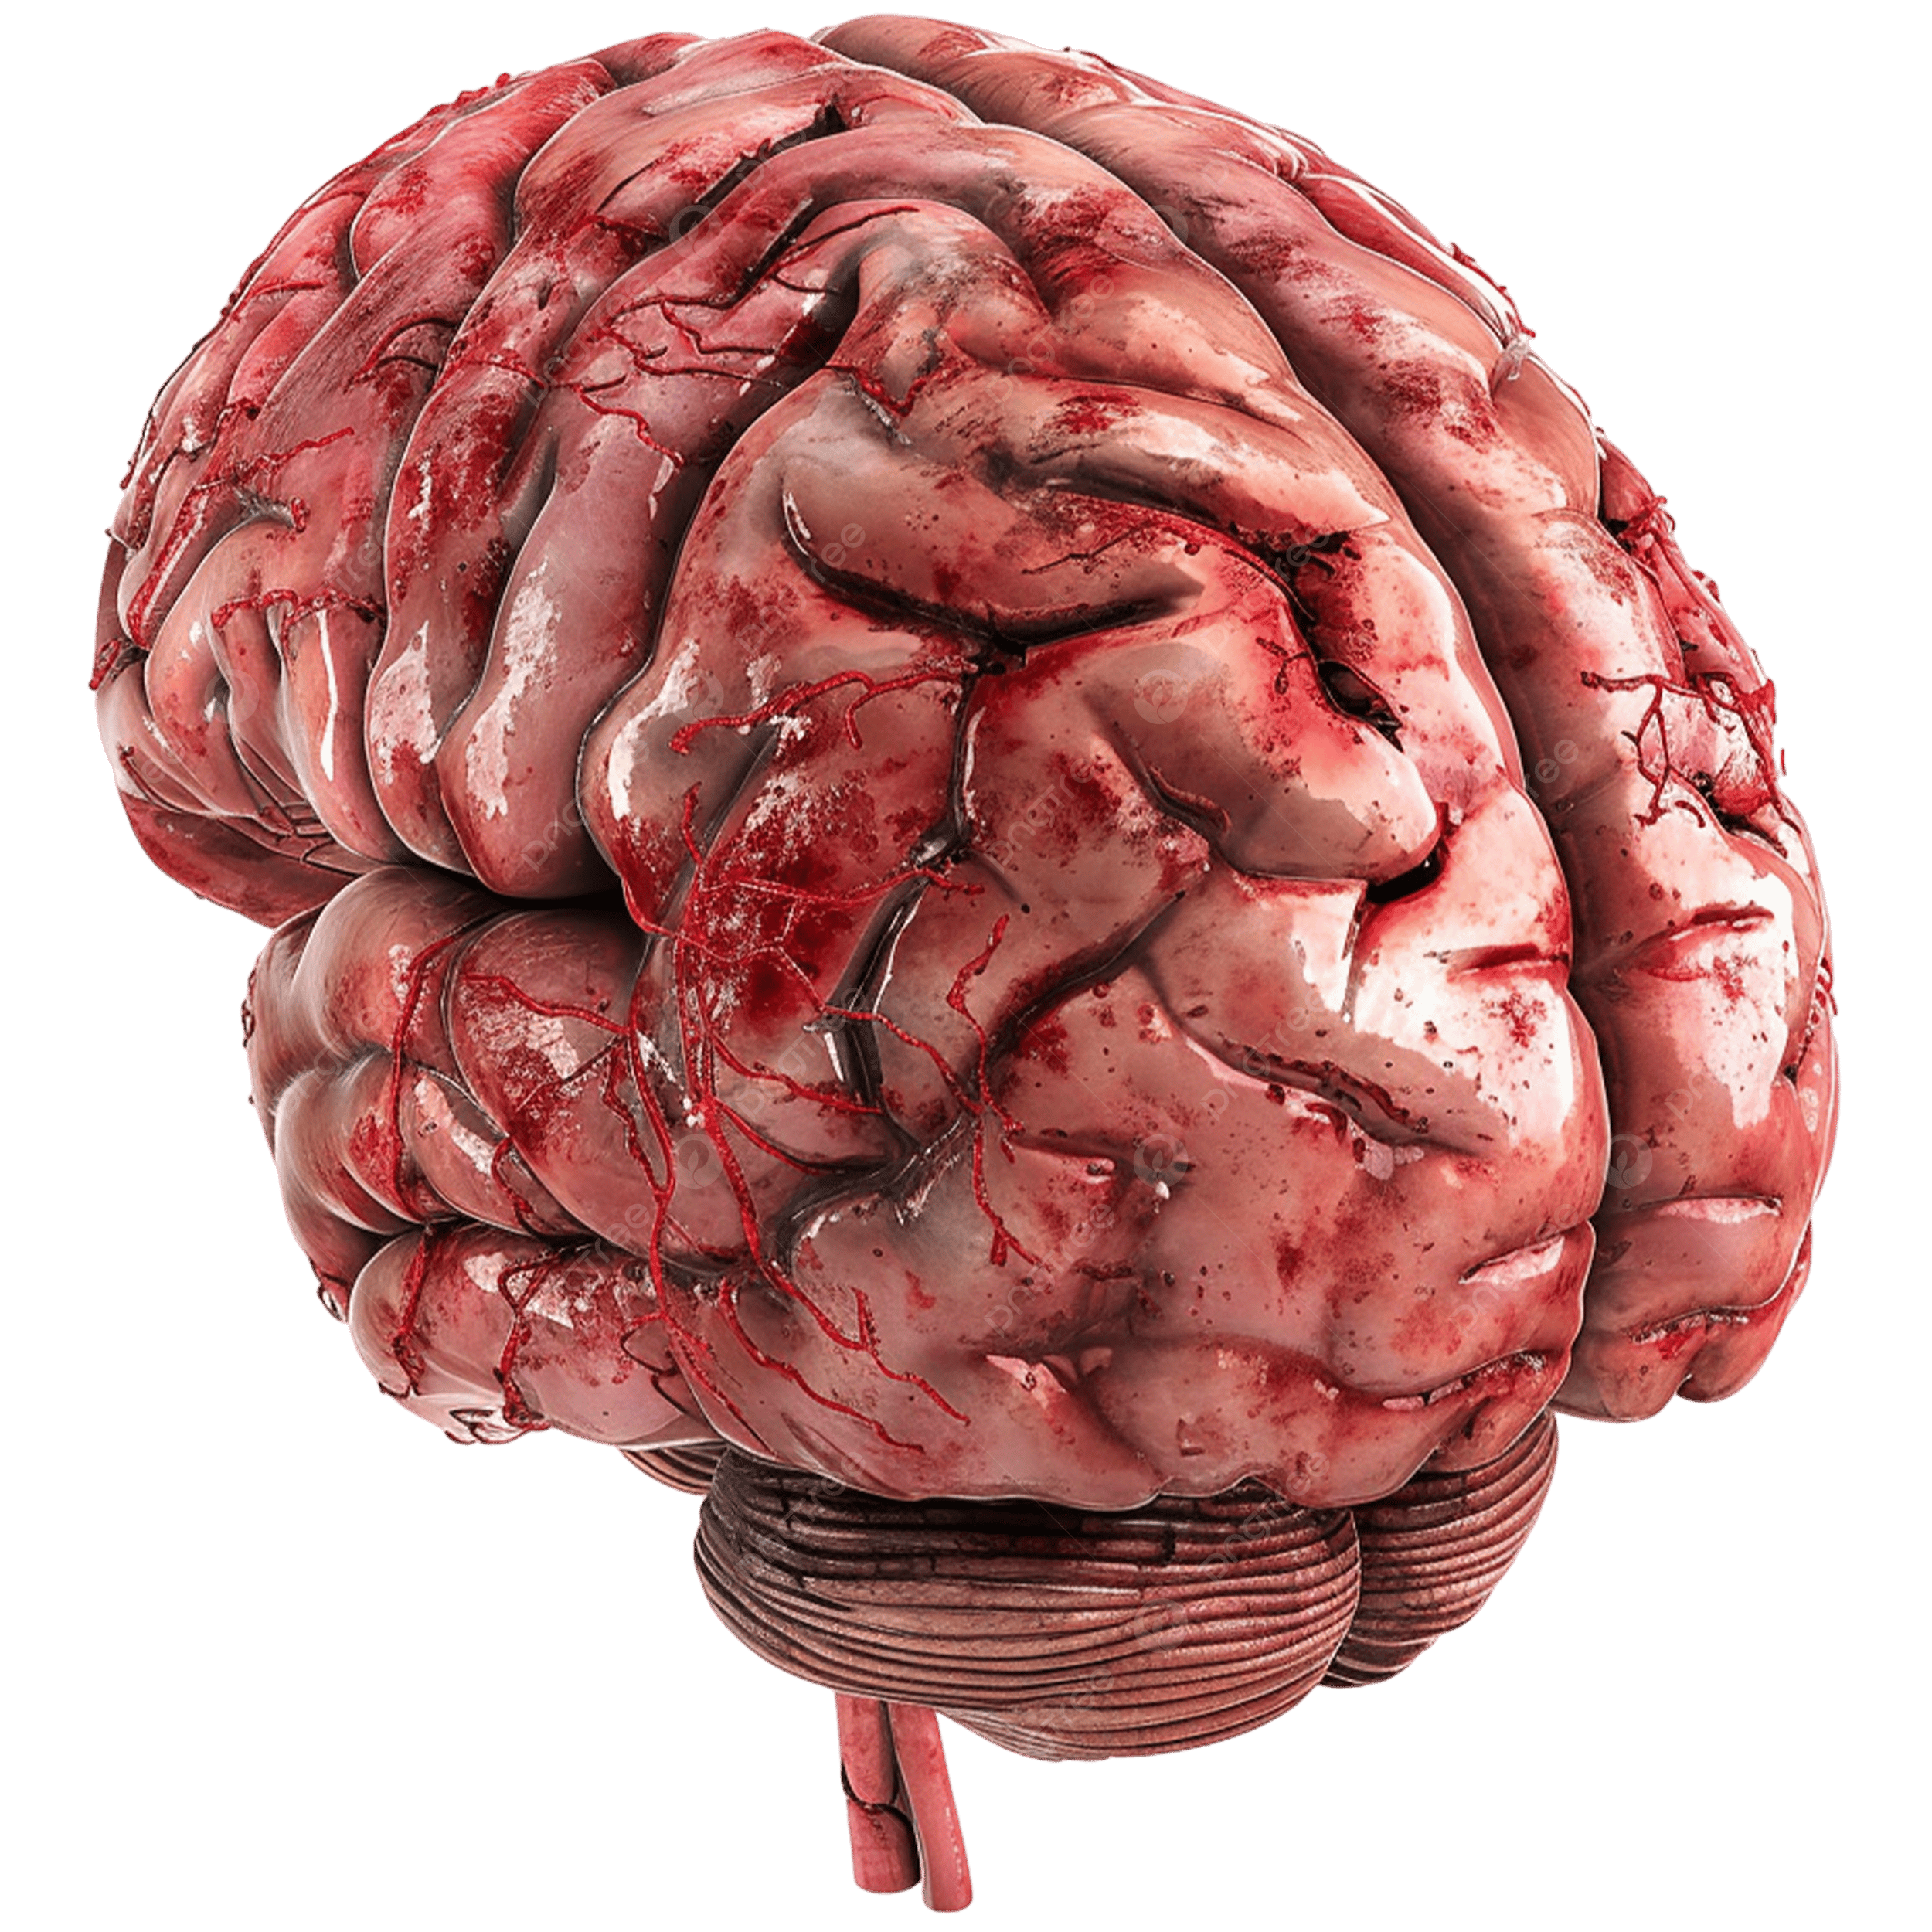
What is Hyperspectral Imaging ?
An RGB image represents visual information using three colour channels: Red (R), Green (G), and Blue (B). Each pixel is described by three intensity values corresponding to these channels, and their combination produces the colours visible to the human eye. RGB images provide information about the spatial appearance, colour, shape, texture, and boundaries of objects within a scene.
Key points:
3 spectral channels: Red, Green, and Blue
Provides spatial information — where objects and structures are located
Provides visible colour information
Helps identify shape, texture, edges, and boundaries
RGB provides rich visual and spatial information, but it captures only three broad portions of the electromagnetic spectrum.

Slide 4
What is Hyperspectral Imaging ?
An RGB image represents visual information using three colour channels: Red (R), Green (G), and Blue (B). Each pixel is described by three intensity values corresponding to these channels, and their combination produces the colours visible to the human eye. RGB images provide information about the spatial appearance, colour, shape, texture, and boundaries of objects within a scene.
Key points:
3 spectral channels: Red, Green, and Blue
Provides spatial information — where objects and structures are located
Provides visible colour information
Helps identify shape, texture, edges, and boundaries
RGB provides rich visual and spatial information, but it captures only three broad portions of the electromagnetic spectrum.

Slide 5

What is Hyperspectral Imaging ?
A hyperspectral image captures information across many narrow and continuous spectral bands, rather than only the three Red, Green, and Blue channels. Each pixel contains both its spatial location and a detailed spectral signature, representing how that point interacts with light across different wavelengths.
Key points:
Hundreds of spectral channels/bands instead of only 3
Provides spatial information — location, shape, texture, and boundaries
Provides detailed spectral information for every pixel
Each pixel is represented as a spectral signature:
$$\boxed{\left[I_{λ_{1}} , I_{λ_{2}} , I_{λ_{3}} , … , I_{λ_{n}}\right]}$$
Different materials or tissues can have different spectral signatures, even when they appear visually similar

Slide 6

What is Hyperspectral Imaging ?
A hyperspectral image captures information across many narrow and continuous spectral bands, rather than only the three Red, Green, and Blue channels. Each pixel contains both its spatial location and a detailed spectral signature, representing how that point interacts with light across different wavelengths.
Key points:
Hundreds of spectral channels/bands instead of only 3
Provides spatial information — location, shape, texture, and boundaries
Provides detailed spectral information for every pixel
Each pixel is represented as a spectral signature:
$$\boxed{\left[I_{λ_{1}} , I_{λ_{2}} , I_{λ_{3}} , … , I_{λ_{n}}\right]}$$
Different materials or tissues can have different spectral signatures, even when they appear visually similar

Slide 7
Deep Margin Cosine Autoencoder (DMCA)
The paper proposes a combination of these three ideas in order to perform accurate detection
Deep Autoencoder
Learns hierarchical features from hyperspectral data.
Sparsity
Encourages selective deep features.
Margin Cosine Softmax
Makes features:
compatible with the classifier
more discriminative
better separated in angular space

Slide 8
What is an Autoencoder ?
An autoencoder is a neural network designed to learn a meaningful representation of input data. It consists of two main components: an encoder, which transforms the original input into a learned feature representation, and a decoder, which attempts to reconstruct the original input from those learned features.
The main objective of an autoencoder is to ensure that the reconstructed output remains as similar as possible to the original input. In order to achieve accurate reconstruction, the encoder must learn and preserve the most important underlying characteristics of the input data.
For medical hyperspectral imaging, the input to an autoencoder is the spectral information associated with a pixel. Instead of directly using all original spectral measurements for classification, the encoder learns a new representation containing the important patterns present in the spectral data.
Input Spectrum
Encoder
Learned Features
Decoder
Reconstructed Spectrum

Slide 9
What is an Autoencoder ?
A single autoencoder can learn a representation of the input data; however, complex data such as medical hyperspectral images may contain patterns that are difficult to represent using only one transformation. Therefore, multiple autoencoder layers can be stacked together to form a Deep Autoencoder (DAE).
In a deep autoencoder, the output representation learned by one layer becomes the input to the next layer. As the data passes through successive layers, the network learns increasingly deeper and more abstract feature representations.
The paper considers the Stacked Autoencoder (SAE) as the specific form of the Deep Autoencoder framework used in the proposed method. The multiple layers are used to mine and extract deep features from the medical hyperspectral image.
Successive layers allow the network to progressively transform the original hyperspectral measurements into higher-level features that can be more useful for classification.
Input Spectrum
Encoder
Learned Features
Encoder
Reconstructed Spectrum
Learned Features
Encoder
Learned Features
Encoder
Learned Features
Decoder

Slide 10
What is an Autoencoder ?
A learned feature representation can be either dense, where many features are simultaneously active, or sparse, where only a limited number of features have significant values.
Dense Representation
Sparse Representation
[0.4, 0.7, 0.5, 0.3, 0.8, 0.6]
[0, 0.9, 0, 0, 0.7, 0]
In this representation, almost every feature is active.
Here, only a small number of features are strongly active.
Sparsity encourages the network to learn a more selective representation in which only the most relevant deep features respond strongly to a particular input.

Slide 11
What is an Autoencoder ?
First, the Deep Autoencoder extracts features from the input. Then, a classifier—commonly a Softmax classifier—is applied to those features to predict the final class.
The paper argues that these two stages are relatively independent. The feature extractor learns representations without directly considering the requirements of the final classifier. As a result, even though the extracted features may represent the input well, they may not necessarily be optimally structured for the classifier used to make the final decision.
DMCA Attempts to learn :
DMCA does not treat feature extraction and classification as completely independent processes; it encourages the learned features to be inherently suitable for the classifier that will use them.
Features that are simultaneously
Representative of the
input
Sparse
Compatible with the classifier

Slide 12

Why Cosine Similarity and Margin?
In classification, features belonging to different classes should ideally be well separated. If the learned feature representations of two classes are too close or overlap significantly, the classifier may have difficulty distinguishing between them.
DMCA uses cosine similarity to measure the relationship between learned features and class-related weight vectors.
Cosine similarity is based on the angle between two vectors:
$$\boxed{cos⁡\left(θ\right)}$$
where $θ$represents the angle between the vectors.
A higher cosine similarity indicates that the two vectors are more closely aligned in direction, while a lower similarity indicates greater angular separation.
What Does the Margin Do?
DMCA introduces an additional cosine margin into the Softmax loss.
The purpose of this margin is to increase the separation between features belonging to different classes in the angular space.
Close gap – may cause errors
Margin – reduces classification error

Slide 13
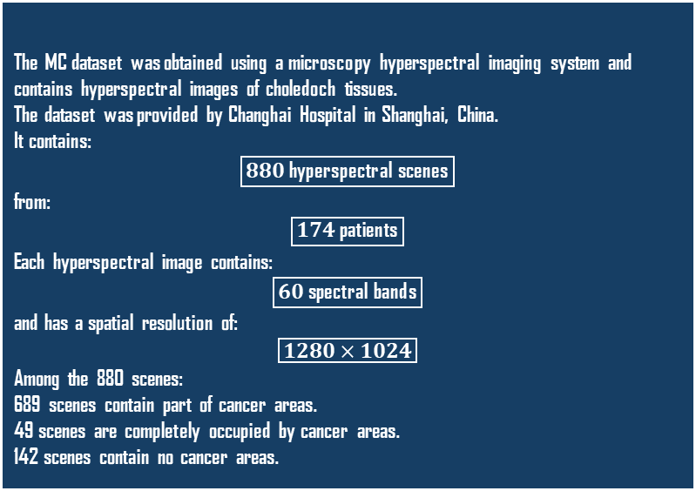
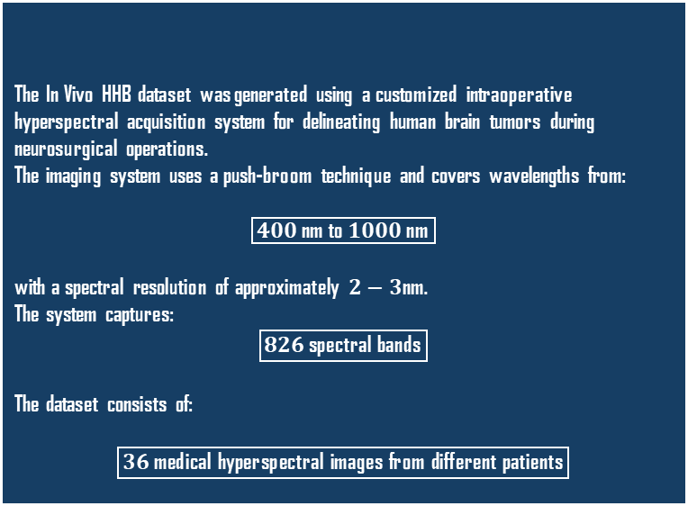
Experimental Datasets
The proposed DMCA is evaluated on both brain tumor hyperspectral images and cholangiocarcinoma-related choledoch hyperspectral images to establish its universal applications.
In Vivo Hyperspectral Human Brain Dataset
Multidimensional Choledoch (MC) Dataset
The In Vivo HHB dataset was generated using a customized intraoperative hyperspectral acquisition system for delineating human brain tumors during neurosurgical operations.
The imaging system uses a push-broom technique and covers wavelengths from:
$$\boxed{400\text{ nm to }1000\text{ nm}}$$
with a spectral resolution of approximately $2−3$nm.
The system captures:
$$\boxed{826\text{ spectral bands}}$$
The dataset consists of:
$$\boxed{36\text{ medical hyperspectral images from different patients}}$$
The MC dataset was obtained using a microscopy hyperspectral imaging system and contains hyperspectral images of choledoch tissues.
The dataset was provided by Changhai Hospital in Shanghai, China.
It contains:
$$\boxed{880\text{ hyperspectral scenes}}$$
from:
$$\boxed{174\text{ patients}}$$
Each hyperspectral image contains:
$$\boxed{60\text{ spectral bands}}$$
and has a spatial resolution of:
$$\boxed{1280×1024}$$
Among the 880 scenes:
689 scenes contain part of cancer areas.
49 scenes are completely occupied by cancer areas.
142 scenes contain no cancer areas.

Slide 14
Two Stage Training
To test the robustness of the AI, the authors used a uniquely strict train-test split of 0.01-99.99. This
simulates a realistic surgical scenario where surgeons have almost no prior labelled data to work with
Stage 1: Training the First $J−1$Layers
In the first training stage, the initial $J−1$layers of the Deep Autoencoder are trained.
These layers learn hierarchical deep representations from the original medical hyperspectral input.
The output generated by the ${\left(J−1\right)}^{th}$layer becomes the learned representation that is passed to the final deepest layer.
Purpose
Learn an initial hierarchical representation of the medical hyperspectral data.
Stage 1: Training the First 𝐽−1Layers
In the first training stage, the initial 𝐽−1layers of the Deep Autoencoder are trained.
These layers learn hierarchical deep representations from the original medical hyperspectral input.
The output generated by the (𝐽−1)^𝑡ℎlayer becomes the learned representation that is passed to the final deepest layer.
Purpose
Learn an initial hierarchical representation of the medical hyperspectral data.
Stage 2: Training the Deepest $J^{th}$Layer
In the second stage, the deepest $J^{th}$layer is trained independently.
The input $H_{J}$for this stage is obtained from the output of the first $J−1$trained layers.
At this deepest layer, DMCA simultaneously applies:
Reconstruction learning
$L_{1}$-based sparse regularization
Margin cosine Softmax classification
The paper describes this deepest layer as the unified layer where the deepest sparse autoencoder and the margin cosine term are integrated together.
Stage 2: Training the Deepest 𝐽^𝑡ℎLayer
In the second stage, the deepest 𝐽^𝑡ℎlayer is trained independently.
The input 𝐻_𝐽for this stage is obtained from the output of the first 𝐽−1trained layers.
At this deepest layer, DMCA simultaneously applies:
Reconstruction learning
𝐿_1-based sparse regularization
Margin cosine Softmax classification
The paper describes this deepest layer as the unified layer where the deepest sparse autoencoder and the margin cosine term are integrated together.

Slide 15
Evaluation Metrics
Overall Accuracy
Overall Accuracy represents the percentage of all pixels that are classified correctly.
OA= $\frac{Number of correctly identified pixels}{Total Number of pixels}$​​
Overall Accuracy
Overall Accuracy represents the percentage of all pixels that are classified correctly.
OA= (𝑁𝑢𝑚𝑏𝑒𝑟 𝑜𝑓 𝑐𝑜𝑟𝑟𝑒𝑐𝑡𝑙𝑦 𝑖𝑑𝑒𝑛𝑡𝑖𝑓𝑖𝑒𝑑 𝑝𝑖𝑥𝑒𝑙𝑠)/(𝑇𝑜𝑡𝑎𝑙 𝑁𝑢𝑚𝑏𝑒𝑟 𝑜𝑓 𝑝𝑖𝑥𝑒𝑙𝑠)​​
Average Accuracy
Average Accuracy measures the classification accuracy of each class separately and then calculates their average.
Kappa Coefficient
The Kappa coefficient evaluates the agreement between the predicted classification and the ground truth while accounting for agreement that could occur by chance.
A Kappa value closer to 1 indicates stronger agreement between predictions and ground truth.

Slide 16
Experimental Findings and Ablation Study
According to the paper, DMCA consistently achieved better OA, AA, and Kappa values than the compared methods on the representative brain hyperspectral images.
The classification maps produced by DMCA were also visually closer to the ground-truth labels than those produced by the competing methods.
An especially important result is tumor identification:
99.97% tumor tissue identification rate for one representative brain image.
99.80% tumor tissue identification rate for another representative brain image.
The authors use these results to support the advantage of DMCA for brain cancer diagnosis.
The paper reports that the full DMCA achieves better performance than the version without the cosine margin, supporting the effectiveness of the margin cosine constraint.

Slide 17
Conclusion
The central idea of DMCA is to learn deep hyperspectral features that not only represent the input effectively, but are also sparse, discriminative, and explicitly compatible with the final classifier.
Deep Feature Extraction
A stacked/deep autoencoder learns hierarchical representations from high-dimensional medical hyperspectral data.
Sparse Feature Learning
An $L_{1}$-based regularizer is applied to the deepest feature layer to encourage sparse and selective representations.
Sparse Feature Learning
An 𝐿_1-based regularizer is applied to the deepest feature layer to encourage sparse and selective representations.
Margin Cosine Classification
A cosine margin is incorporated into the Softmax classifier to increase the separation between features from different classes in angular space and make the learned features easier to classify.

